Slide 1





Invest $4M to launch “phygital” clothing line in The Sims 4 for projected $30M return
Tatum 1

Slide 2




05
Lifestyle game
25M monthly active USA users
Target audience ages18-24
Competitors in virtual fashion
SIMS 4
Tatum 2

Slide 3
Timeline: From the Game to Reality
Oct-Nov 2023
Create Virtual Line
$1.5M - Product Design
$1.5M - Tech Outsourcing
Jan-Mar 2024
Track Product Performance
Phygital to Physical
Dec 2023
Holiday Launch
$1M - Marketing
2024+
Expand EA Games
Gunjan 3
Notes:
Opportunity to gauge popularity of potential upcoming lines / predict what to produce physically based on “phygital” popularity
Collectible items / become your character

Slide 4
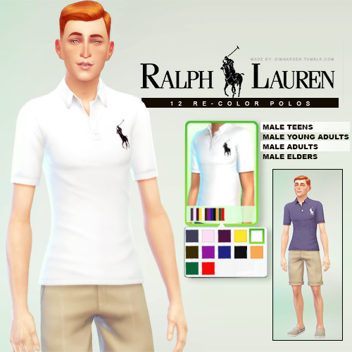
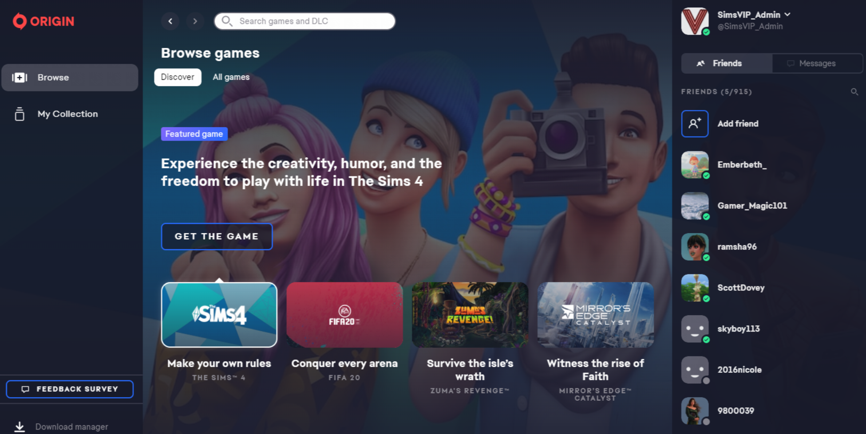

now available!
Tatum 4

Slide 5

Financial Estimations
20%
Commission
to Sims
25M
Players
10%
Conversion
$15 per
Outfit
30M
Revenue
Gunjan 5

Slide 6
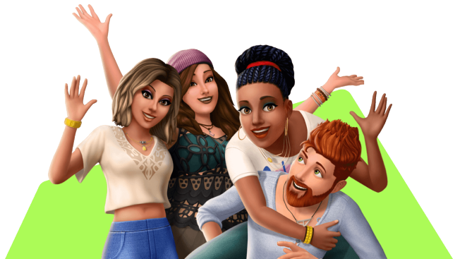
Thank You

Slide 7
Sources
Lee, A. (2023, July 31). How Ralph Lauren’s “Phygital” boot sale in fortnite shows benefits - and limits - of virtual commerce. Glossy. https://www.glossy.co/fashion/how-ralph-laurens-phygital-boot-sale-in-fortnite-shows-benefits-and-limits-of-virtual-commerce/
Moore, T., & Berkowitz, D. (2023, April 18). We inspire the world to play. Electronics Arts. https://ir.ea.com/press-releases/press-release-details/2023/The-Sims-4-Becomes-the-Most-Widely-Played-Game-in-the-23-Year-History-of-the-Franchise-With-More-Than-70-Million-Players-Worldwide/default.aspx
simgarden. (2017, November 6). Simgarden: Lauren Sims, Sims 4, Sims 4 clothing. Pinterest. https://www.pinterest.com/pin/360358407676064609/
Smith, P. (2022, August 31). Gen Z Apparel Shopping Frequency 2022. Statista. https://www.statista.com/statistics/1328167/gen-z-apparel-shopping-frequency-gender/
us-pdee. (n.d.). Polo Ralph Lauren X fortnite P-wing 1992 Boot Size 13 (only 300 made) new in box. eBay. https://www.ebay.com/itm/305153693064?chn=ps&norover=1&mkevt=1&mkrid=711-117182-37290-0&mkcid=2&mkscid=101&itemid=305153693064&targetid=1528987488216&device=c&mktype=pla&googleloc=9030244&poi=&campaignid=19851828444&mkgroupid=145880009014&rlsatarget=pla-1528987488216&abcId=9307249&merchantid=6296724&gclid=Cj0KCQjwm66pBhDQARIsALIR2zBhXxZhqPl9RV8eG8IYr4Nwp3s7ucCEW_G9d3tL44KSuwQL0M0wsu4aAilZEALw_wcB
Young, R. (2021, September 27). 60% of Sims 4 players are women aged 18-24. Game Rant. https://gamerant.com/sims-4-players-majority-young-women/#:~:text=A%20line%20in%20the%20listing’s,ages%20of%2018%20and%2024.

Slide 8
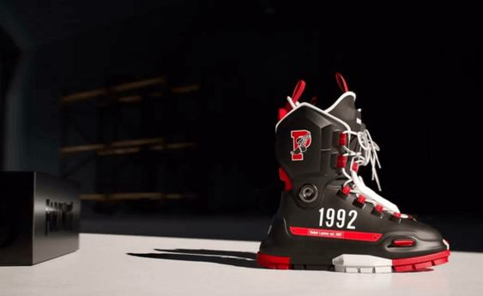
Polo Ralph Lauren + Fortnite:
P-Wing Boot
Physical version released 8/3/23
300 at $250 each
Sold out within minutes
Resales $2,000+

